Slide 1

Block Coding

Slide 2
the technique of adding extra bits to a digital word to improve the reliability of transmission.
Message Bits
Code Bits
Frame synchronzation Bits

Slide 3
Types of block coding
Hamming codes
Reed-Solomon codes
BCH codes

Slide 4
Encoding and decoding
Keypoints
mB/nB coding – Three steps
Division
Substitution
Combination
Example : 4B/5B(four binary/five binary

Slide 5
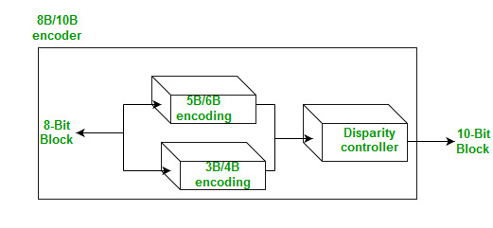

Slide 6
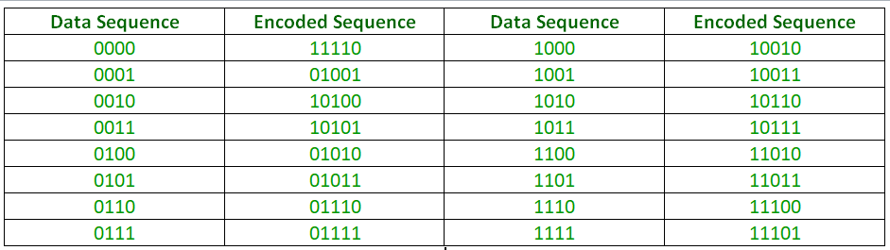

Slide 7
PROS
Improved reliability
Increased data accuracy
Greater efficiency
Robustness

Slide 8
CONS
Increased complexity
Increased overhead
Increased cost

Slide 9
THANK YOU

